Slide 1

K.L.E’s J.T.College, Gadag
Re-accredited by NAAC with “A” grade
“Virtua
L
ab”
Under the Guidance of
Prof. Sneha Palankar
Project Associates :
Akshay Vyas (13U11608)

Slide 2
CONTENTS
ABSTRACT
INTRODUCTION
HARDWARE & SOFTWARE REUIRMENT
MODULES
DATA FLOW DIAGRAM
IMPLEMENTATION
SCREENSHOTS
FUTURE ENHANCMENT
CONCLUSION
REFERENCCES

Slide 3
ABSTRACT
The thesis explains the construction of “VIRTUALAB” BELIEVE THAT web site. The practical experience is very essential component in education.
The aim of the “VirtuaLab” project is to provide student access the various labs conducted in different Colleges in different ways.
The objective is to develop a user – friendly educational site.

Slide 4
INTRODUCTION
This project is proposed to give the student a VirtuaLab Experience of Various colleges.
Student can now access the Lab Activity of Various Colleges to learn more.
It provides facilities to download the Lab Files and also ask any Query to respected teacher who has uploaded files.

Slide 5
INTRODUCTION
EXISTING SYSTEM: The existing system has to get to walk and collect the Lab activates of various colleges and are unable to contact any good staff for any Lab query of other colleges.
PROPOSED SYSTEM: The proposed system allows user to access the various colleges and to fetch the Lab Activities via VirtuaLab feeling. They can also ask query to teachers to get a complete knowledge.

Slide 6
SYSTEM REQUIREMENTS
SOFTWARE REQUIREMENTS
Windows XP – SP2 / 7 / 8.1 above
SOFTWARE: Dreamweaver
BROWSERS: INTERNET EXPLORE, GOOGLE CHROME
HARDWARE REQUIREMENTS
PROCESSOR: Dual core (2.0) GHz or Core to Duo or above
RAM: 1 GB
HDD: 120GB

Slide 7
MODULES
Definition : A module is a part of a program. Programs are composed of one or more independently developed modules that are not combined until the program is linked. A single module can contain one or several routines.
Modules:
Administrator
College
Staff
Student

Slide 8
DATA FLOW DIAGRAM
DATABASE
ADMIN
College
Virtual
Lab
Staff
Student

Slide 9
DATA FLOW DIAGRAM
ADMIN
College Details
Couser Details
Subject Details
STOP

Slide 10
DATA FLOW DIAGRAM
COLLEGE
College Validation
Course
STOP
Staff

Slide 11
DATA FLOW DIAGRAM
STAFF
STAFF Validation
Subject
Add File
Description
STOP
Query

Slide 12
DATA FLOW DIAGRAM
STUDENT
STUDENT Validation
college
department
subject
lab
STOP
query

Slide 13
IMPLEMENTATION
ADMINISTRATOR
The web Site is managed by the administrator, with the various activities like adding of Various college details, maintaining the faculties and their details of documentation, overviewing the student details and managing the various activities.

Slide 14
IMPLEMENTATION
COLLEGE
College has to get registered by the admin rights, once the college is registered it can then add its all Staff through which those staff are allowed to participate in the VirtuaLab.

Slide 15
IMPLEMENTATION
STAFF
The Staff has to register to the college,. Once after the registration , they can upload the Lab activities of each lab. They can also give some description on the lab activities so that the student can understand in the easy way.

Slide 16
IMPLEMENTATION
STUDENT
The student has to register himself to the belonging college with valid details. Once the registration is successful he can then access the Lab Activities of any colleges and get the knowledge and requirement in a convenient way.

Slide 17
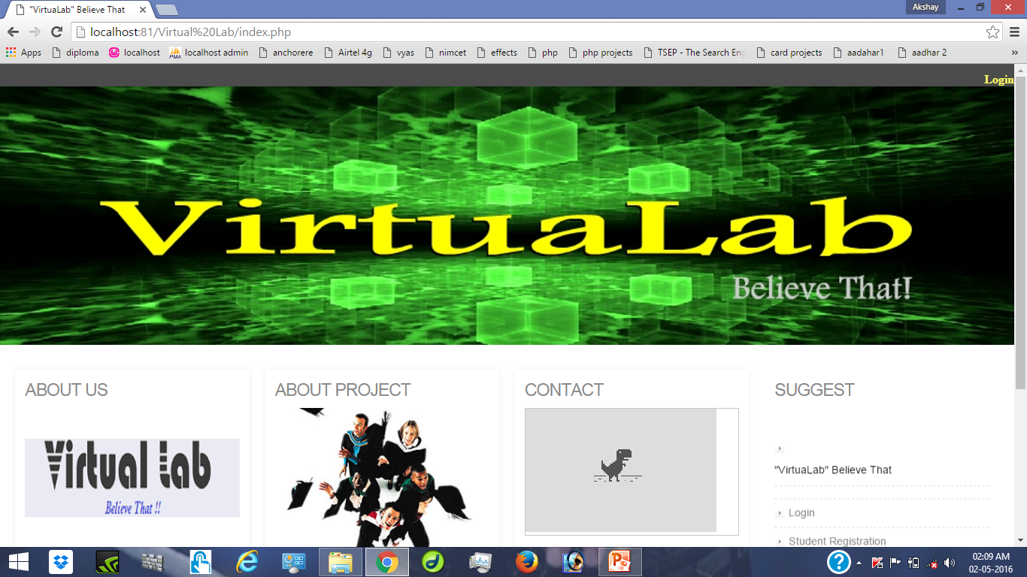

Slide 18
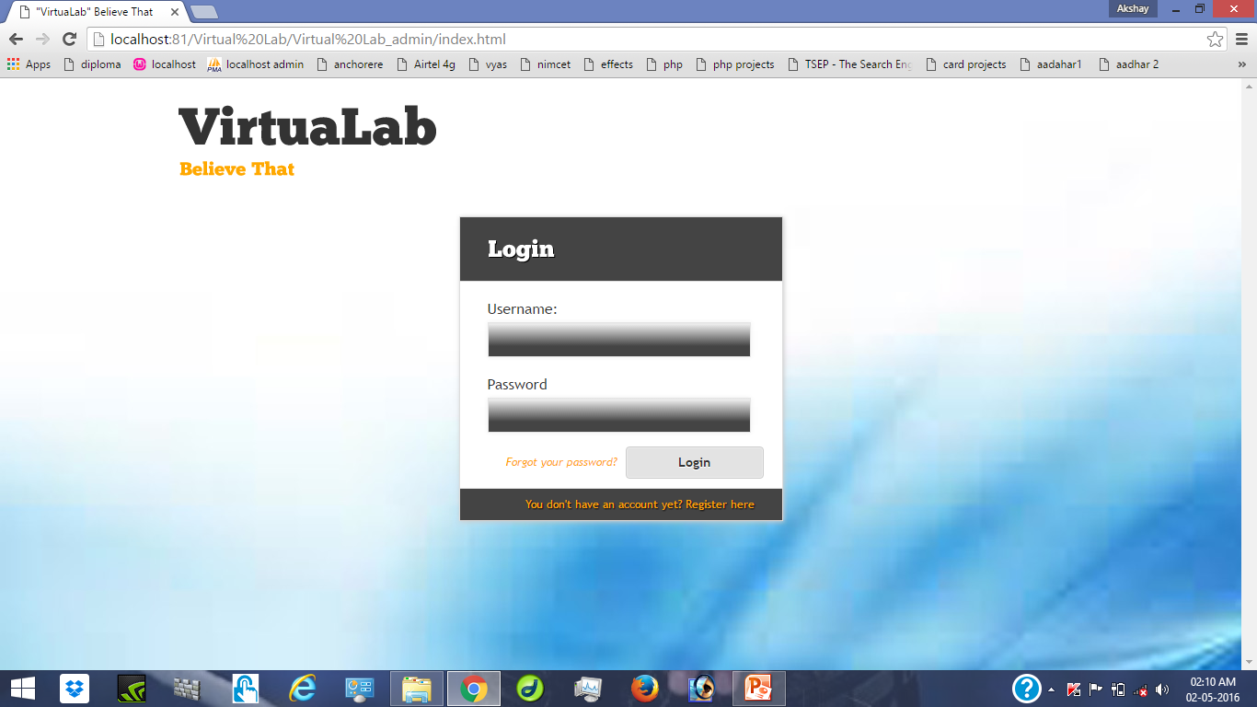
Fig. 1:Showing Home Page

Slide 19
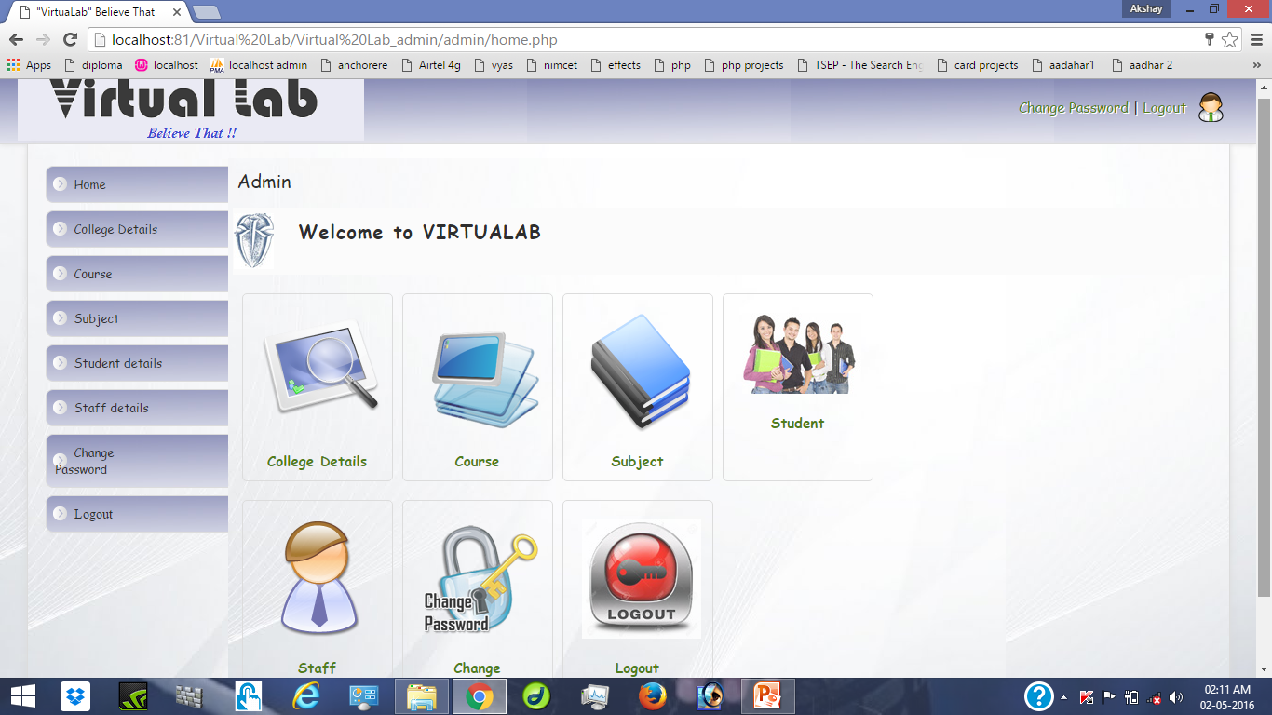

Slide 20
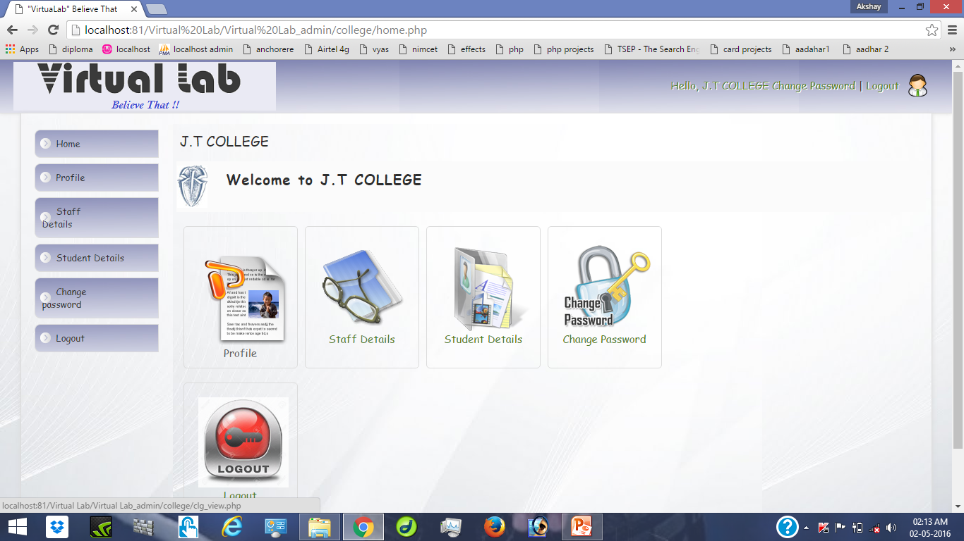
The below figure shows the setting up of password for the application and saving it. On clicking the back button it comes out of the Password setting page.
Fig. 2:Showing The Setting Of Password

Slide 21
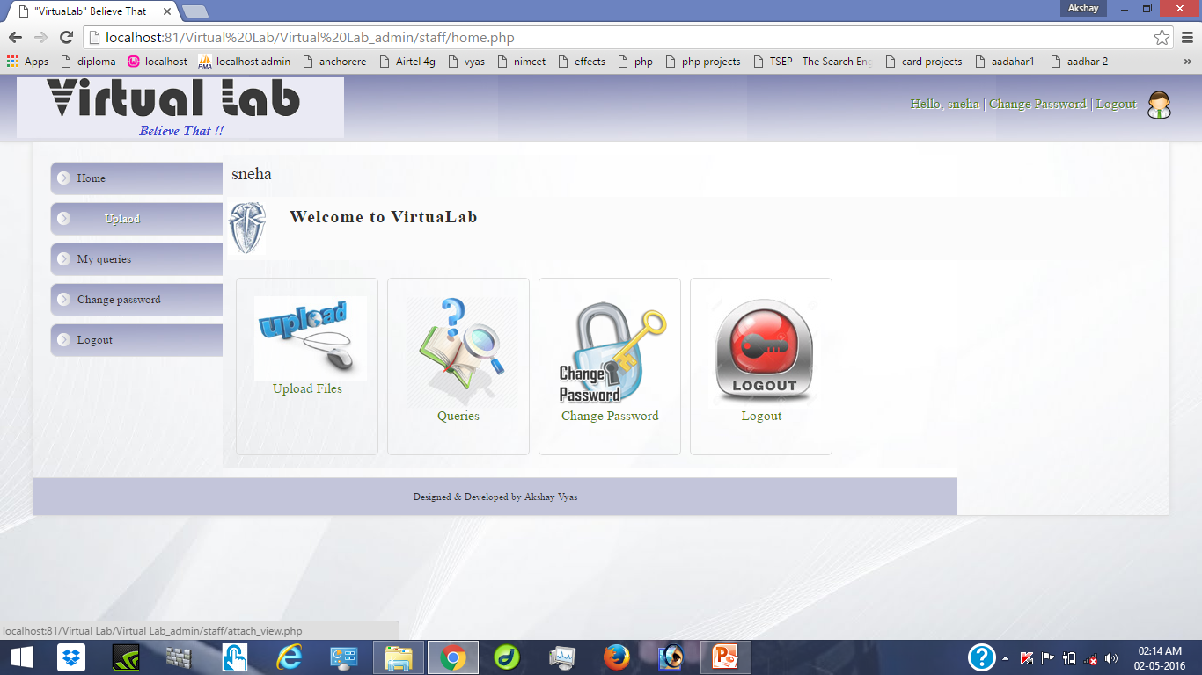
FETCHING CONTACT INFORMATION

Slide 22
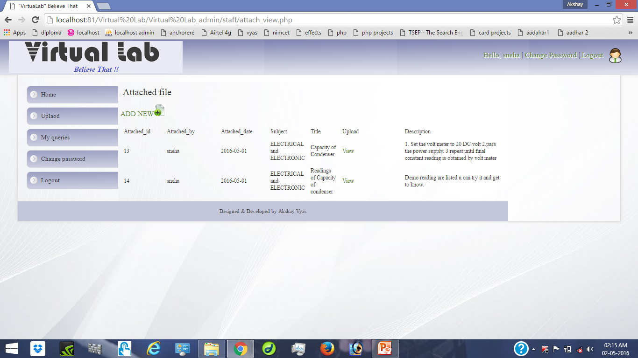

Slide 23
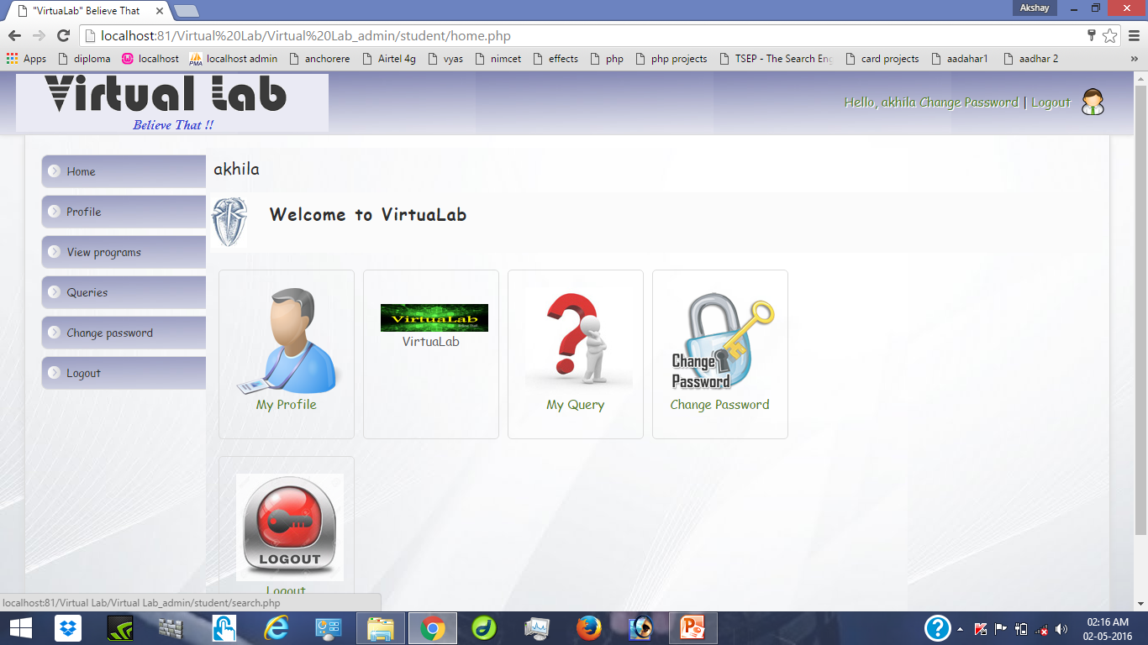

Slide 24
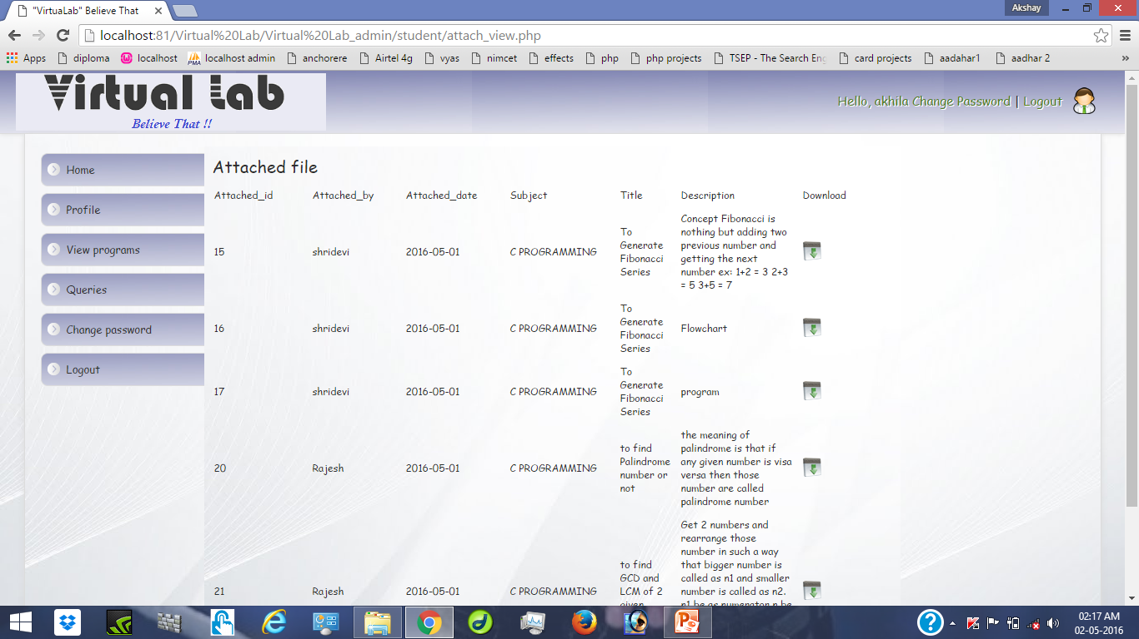

Slide 25
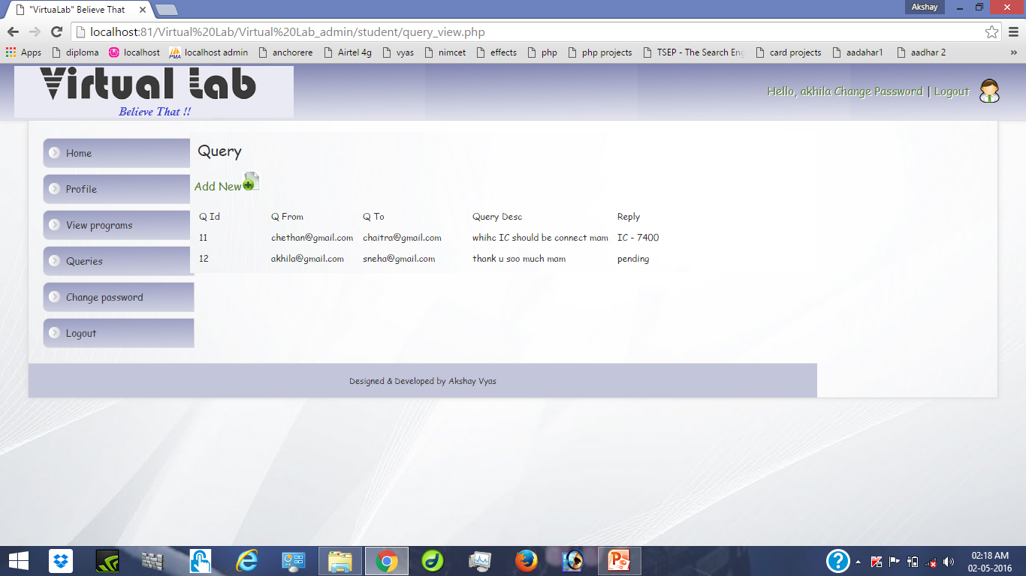

Slide 26
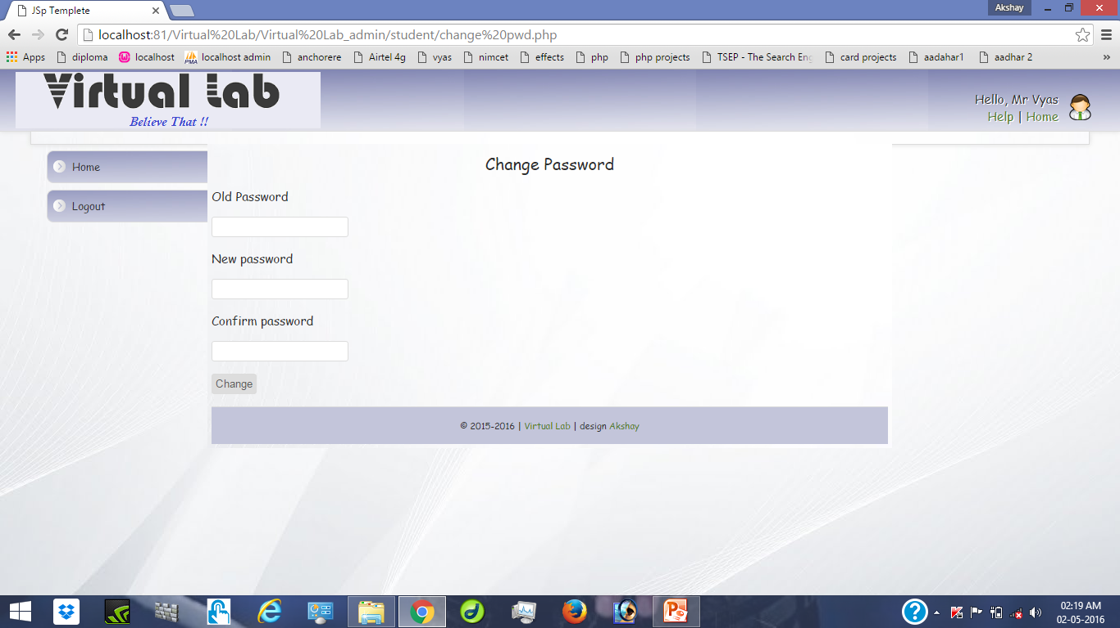

Slide 27
FUTURE ENHANCEMENT
Though this was not part of objective of this project but it would have great to implement that, provided I’d enough time.
Some of them are listed down:
“VIRTUALAB” Believe That, will be made more effective and realistic by providing students a live video streaming of Lab Practical’s.
A module from where entities can communicate.
And faster process for subjective flash news, regular events, staff notifications.

Slide 28
ADVANTAGES
Time saving.
No scarce of eminent teachers.
Deep knowledge on subject.
Clearances of all subjects.

Slide 29
CONCULSION
By implementing this project will be successfully able to provide the VirtuaLab experiences. The proposed model facilitates accessing other colleges LAB ACTIVITES. The system has been designed in such a way that any student from any college can access lab of various colleges.

Slide 30

THANK YOU

